Slide 1
Meta Word Embeddings for Marathi
Saurabh Hemant Tandale 2020HCS7019
Date: 21/05/2021

Slide 2
Generation of the optimised word embeddings from the existing embeddings with the help of Ensemble Learning
Objective

Slide 3
Motivation
Less exploration of Marathi language (comparatively)
Less Data Available
So need a clever approach
Existing Deep Learning approaches which can handle such problems
Less manual and more promising
Available Mathematical Approach
More insightful
Mother tongue

Slide 4
Methods
Mathematical Approach
SOLS
Solution with Ordinary Least Square Method
SOPP
Solution with Orthogonal Procrustes Problem
Autoencoders
CAEME
Concatenated Autoencoded Meta-Embedding
AAEME
Averaged Autoencoded Meta-Embedding

Slide 5
Data
Training
IndicNLP Marathi Corpus
# News Articles = 2.31M
# Sentences = 34.0M
# Tokens = 551M
After Processing
Vocab Size = 1161117
Evaluation
Marathi-WS253
Size = 253
After Processing
Size = 104
Src: https://github.com/syedsarfarazakhtar/
Word-Similarity-Datasets-for-Indian-Languages
Src: https://indicnlp.ai4bharat.org/corpora/

Slide 6
Steps
Processing the Row corpus
Normalization
Punctuation removal
Training N fastText models
Implementation of different Ensemble Models
Evaluation of models over a Task (Word Similarity)

Slide 7
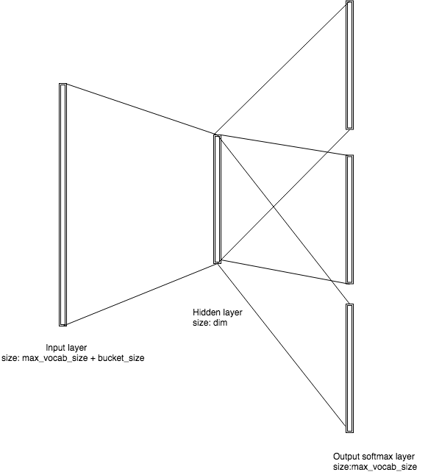
Base Model
Unsupervised Skip-gram fastText model
Src: https://towardsdatascience.com/fasttext-under-the-hood-11efc57b2b3

Slide 8
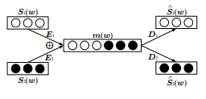
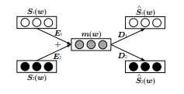



Ensemble Models
Mathematical Approach
Autoencoders
Loop till err < theta
Solve r linear Regression Problem (J)
Update estimated Y
end
CAEME
err =
AAEME
Src: https://arxiv.org/abs/1704.01419
Src: https://www.aclweb.org/anthology/C18-1140/

Slide 9
Evaluation
Word Similarity Task
Mathematical Approach
SOLS
Correlation = 40
SOPP
Correlation = 50
Autoencoders
CAEME
Correlation = 43
AAEME
Correlation = 49

Slide 10
Discussion
Use different Corpus
Use different word embedding models
Use different Ensemble Models
Data Ensemble
Model Ensemble
Evaluate over different Tasks
Word Similarity
Word Analogy

Slide 11
References
[1] Kushagra Bhatia, Divyanshu Aggarwal, Ashwini Vaidya. 2021. Fine-tuning distributional semantics models for closely-related languages. In the proceedings of VarDial- English Workshop on NLP for similar language, Varieties and dialects at EACL 2021.
[2] Avo Muromagi, Kairit and Sven Laur. 2017. Linear ensemble of word embedding Models.
[3] Wenpeng Yen and Hinrich Schutze. 2016. Learning Meta-Embeddings by Autoencoding
[4] Divyanshu Kakwani , Anoop Kunchukuttan , Satish Golla , Gokul N.C, Avik Bhattacharyya , Mitesh M. Khapra , Pratyush Kumar. 2020. IndicNLPSuite: Monolingual Corpora, Evaluation Benchmarks and Pre-trained Multilingual Language Models for Indian Languages.
[5] https://github.com/anoopkunchukuttan/indic_nlp_library

